Slide 1
PROFIT ANALYSIS USING REGRESSION
Submitted by: chilakala swathi
Tools used: MYSQL, Microsoft excel, Power BI

Slide 2
Objective & problem statement
Objectives
To analyze the impact of R&D spend, marketing spend, and administration spend on startup profit using regression analysis.
To predict profit values using regression coefficients and Power BI.
Problem statement
identify the factors that influence startup profit.
Predict profit for given expenditure values using regression analysis.

Slide 3
Dataset description
Dataset name: startup profit analysis dataset
Total records: 50
Total columns: 5
Source: MYSQL database
Dataset features:
RD_spend
Administration
Marketing_spend
State
Profit

Slide 4
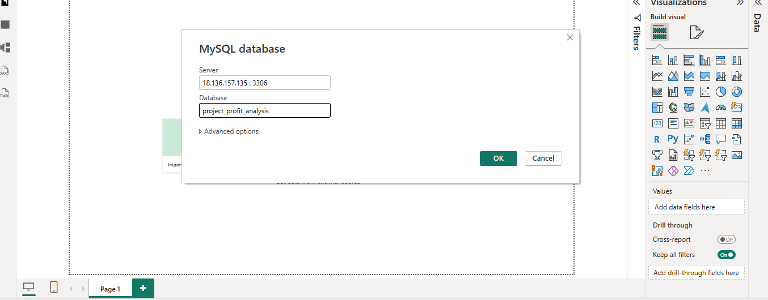
Data import and cleaning
Dataset imported from MYSQL database.
Checked for missing values.
Verified data types.
Checked duplicate records.
Validated numerical columns
Dataset was ready for analysis.

Slide 5
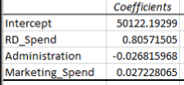
Regression output
Regression analysis were performed using Microsoft excel.
Profit was considered as the dependent variable.
Independent variables:
RD_spend
Administration
Marketing_spend
The obtained coefficients were used for profit prediction in Power BI.

Slide 6
DAX Measures and profit prediction
Total profit
Average profit predicted profit = intercept +
Total RD spend (coefficient * RD_spend) +
Total marketing spend (coefficient *Administration) +
Total administration spend (coefficient * Marketing_spend)
Predicted profit 1
Predicted profit 2
Profit values were predicted using regression coefficients and DAX measures in Power BI.

Slide 7
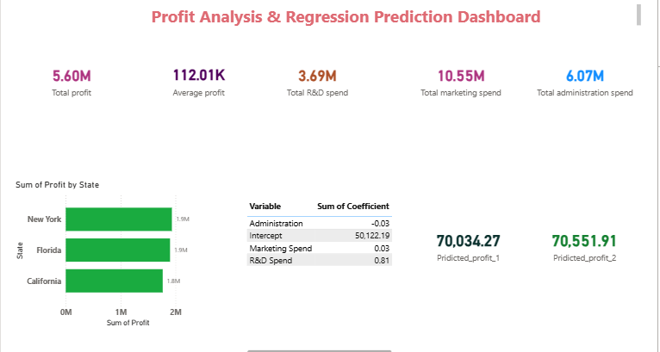
Profit prediction dashboard
dashboard displays key profit metrics.
Predicted profit values were calculated using DAX measures.
KPI cards provide a quick overview of business performance.

Slide 8
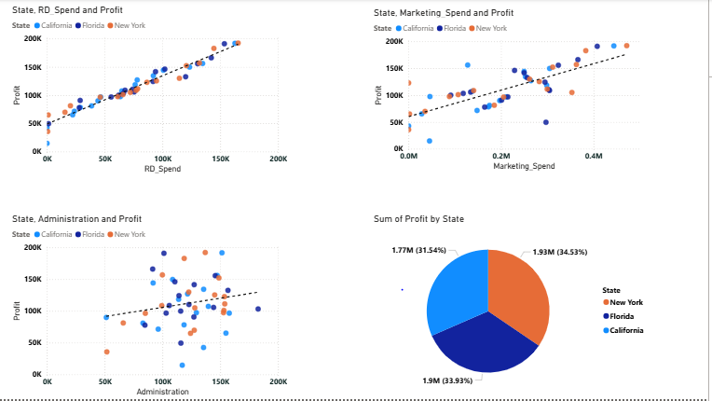
Regression analysis & visualizations dashboard
Scatter charts show the relationship between spending variables and profit.
R&D spend shows the strongest positive relationship with profit.
Marketing spend has a moderate impact on profit.
Administration spend has a relatively lower impact on profit.

Slide 9
Key Insights & Recommendations
Key insights:
R&D spend has the strongest positive impact on profit.
Marketing spend has a moderate positive impact on profit.
Administration spend has minimal impact on profit.
Higher R&D investments generally result in higher profits.
Profit prediction was successfully performed using regression analysis.
Recommendations:
Increase investment in R&D activities.
Optimize administrative expenses.
Continue strategic marketing investments.
Focus on innovation and product development.
Use data-driven decision making for future growth.

Slide 10
conclusion
The project successfully analyzed startup profit using regression analysis.
Power BI dashboards were created to visualize profit trends and spending patterns.
Profit predictions were generated using regression coefficients and DAX measures.
R&D spend was identified as the most influential factor affecting profit.
The project provides valuable insights for business decision-making

